Slide 1
Software Development Project
AAPP006-4-2 & Version 1
Data Flow Diagram and
Data Dictionary

Slide 2
Topic & Structure of The Lesson
Definition
Notation

Slide 3
Learning Outcomes
At the end of this topic, You should be able to produce a DFD and data dictionary of your system

Slide 4
Key Terms You Must Be Able To Use
If you have mastered this topic, you should be able to use the following terms correctly in your assignments and exams:
Context Diagram
Data Flow Diagrams

Slide 5
Data Flow Diagram (DFD)
To show the processes that data undergo in a system
To show how data moves and changes through an information system

Slide 6
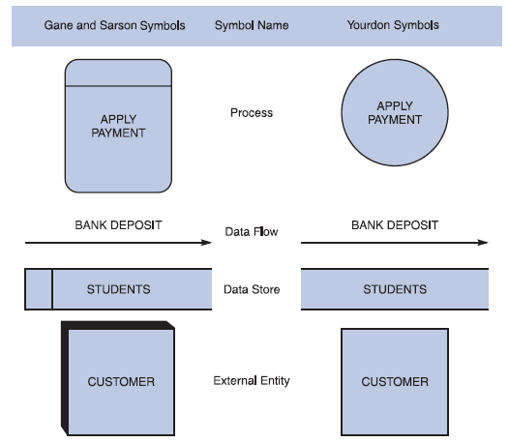
Basic Symbols

Slide 7
Basic Symbols : External Entity
is a person, department, outside organization, or other information systems that provides data to the system or receives data from the system
may be a source, a sink or both
source
an external entity that supplies data
Also known as the origin
sink
an external entity that receives data
Also known as a destination
is named using the singular form of the name

Slide 8
Basic Symbols: Process
modifies or changes data from one form to another form
is named to identify the function it accomplishes
a DFD should have no more than nine process symbols
name consists of an active verb followed by a singular noun

Slide 9
Basic Symbols: Data Flow
transfer data among data stores, sources or sinks, and processes
can represent a specific piece of data – employee names or a set of data – class list – student numbers & student names
line can be curved or straight
name consists of adjectives and a singular noun

Slide 10
Basic Symbols: Data Store
is a data repository
is used when the system must store data because one or more processes need to use the stored data at a later time
only processes may connect to data stores
name is a plural name consisting of adjectives and a noun

Slide 11
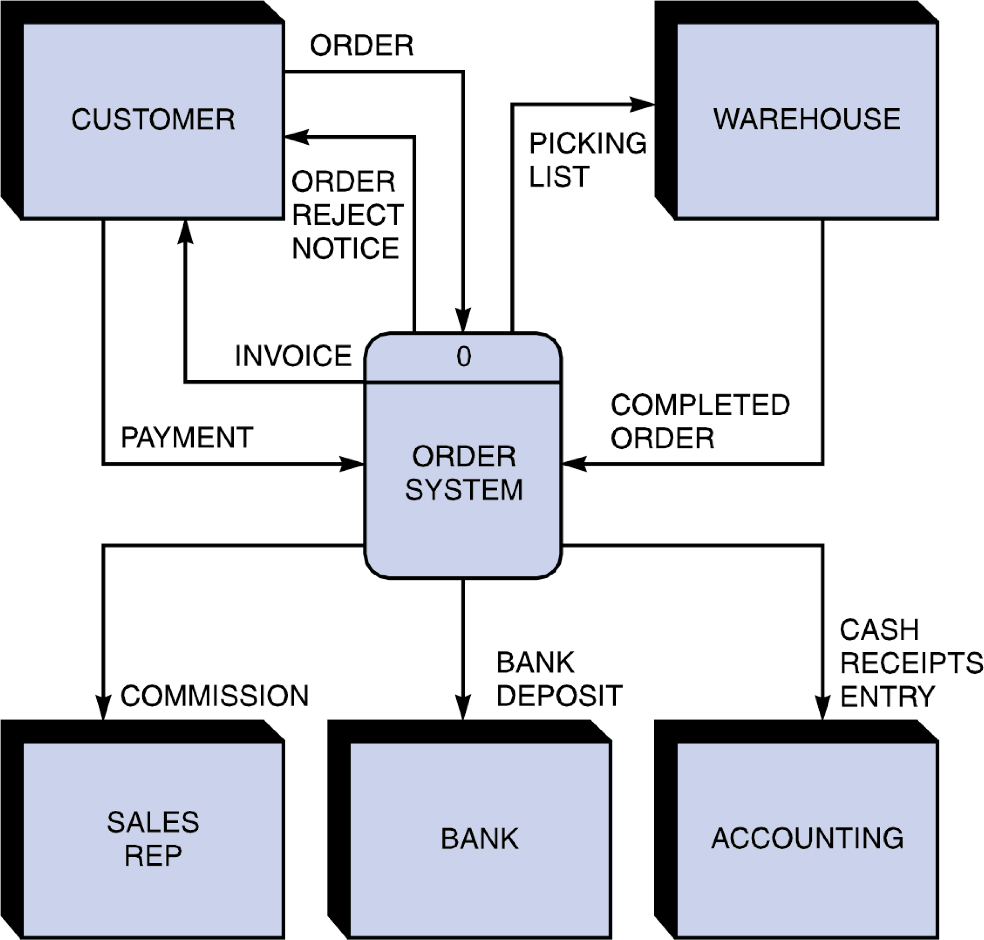
Context Diagram
Checklist:
Has only one process symbol representing the entire information system.
Has the external entities around the perimeter of the page.
Use data flow to connect the external entities with the process.
Do not show data store.

Slide 12
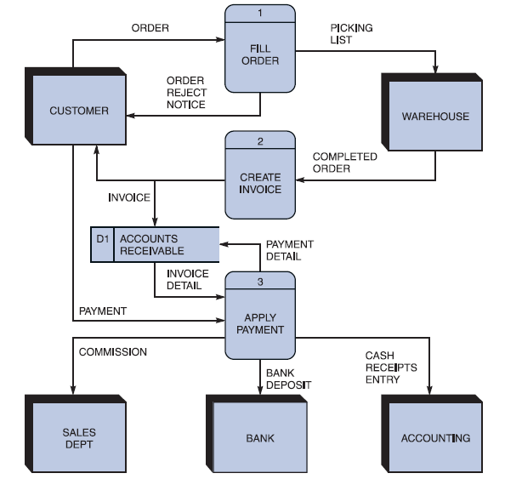
Level 0 DFD
Diagram 0 is an exploded view of process 0
Child diagram
If the same data flows in both directions, you can use a double-headed arrow
maintain consistency among the entire series of diagrams

Slide 13
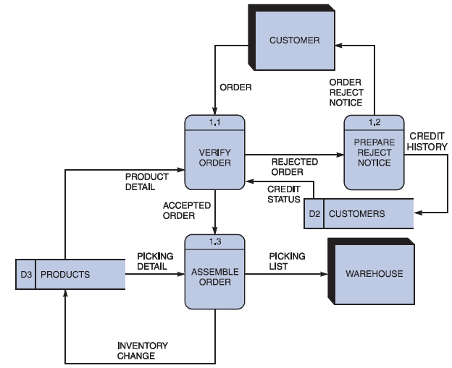
Level 1 DFD
Must use leveling and balancing techniques
Leveling examples
Uses a series of increasingly detailed DFDs to describe an information system
Exploding, partitioning, or decomposing

Slide 14
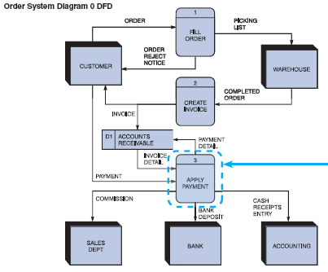
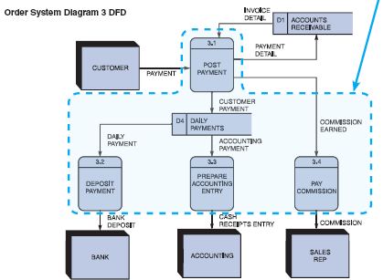
Level 1 DFD

Slide 15
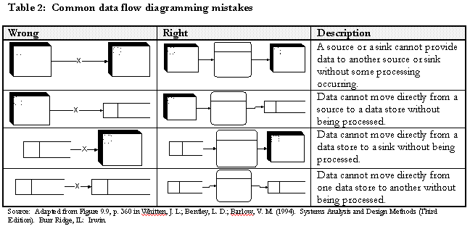
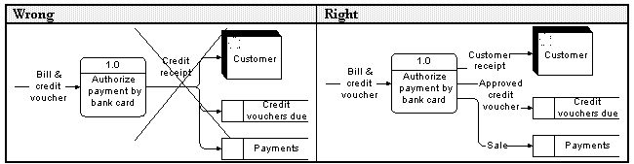
Common Mistakes

Slide 16
Diagramming Mistakes in DFD
The second class of DFD mistakes arises when the outputs from one processing step do not match its inputs.
It is not hard to list situations in which this might occur:
A processing step may have input flows but no output flows. This situation is sometimes called a black hole.
A processing step may have output flows but no input flows. This situation is sometimes called a miracle.
A processing step may have outputs that are greater than the sum of its inputs - e.g., its inputs could not produce the output shown. This situation is sometimes referred to as a grey hole.

Slide 17

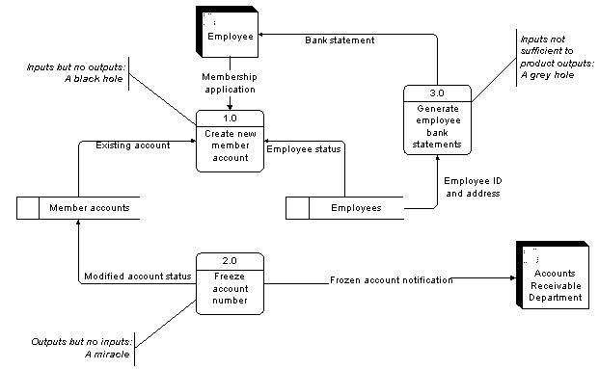
Slide 17 (of

Slide 18
WHAT IS A DATA DICTIONARY ?
Also known as data repository
A reference work of data about data (metadata) which is compiled by systems analysts to guide them through analysis and design
A central storehouse of information about the system’s data
A document that is used to collect and coordinate specific data terms, as well as confirms what each term means to different people in the organization

Slide 19
External Entity
Name: The external entity name as it appears on the DFDs
Description: Of the external entity and its purpose
Input data flows: The standard DFD names for the input data flows into the external entity
Output data flows: The standard DFD names for the output data flows

Slide 20
External Entity
Name : Customer
Description : Customer register details to obtain login details such as Login # and password
Input data flows : Login details
Output data flow : Customer details
Customer record
Registration details
Updated Customer details
1.0
Register
Customer
Customer
Customer details
Login details

Slide 21
Process
Name : Process name and # as it appears on the DFDs
Description : Brief statement of the process’s general purpose
Input data flows : The standard DFD names for the data flows entering the process
Output data flow : The standard DFD names for the data flows leaving the process
Process description : Document the detailed steps for the process – using Structured English

Slide 22
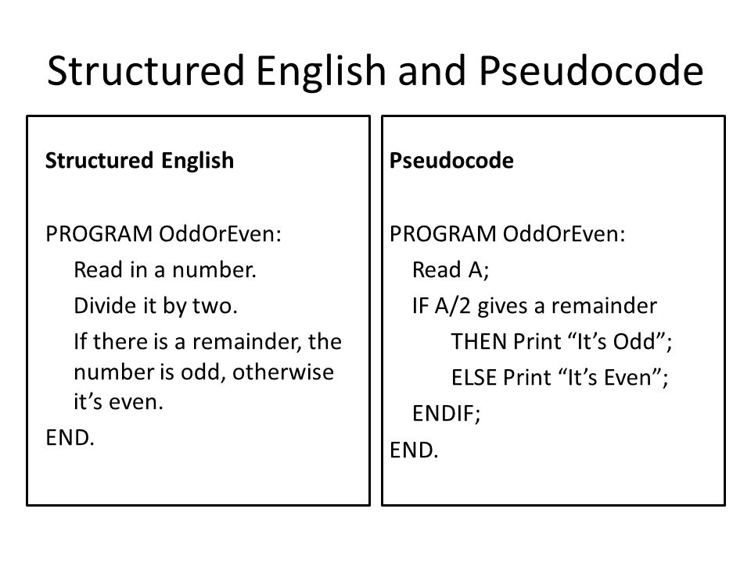

Slide 23
Process
Name : 1.0 Register Customer
Description : Registers customer details into the customer records and retrieves randomly generated password with login
Input data flows : Customer details, Updated Customer details
Output data flows : Login details, Registration details
Process : (Pseudocode)
Customer record
Registration details
Updated Customer details
1.0
Register
Customer
Customer
Customer details
Login details

Slide 24
Process Pseudocode Example
if(first time entry) {
Load registration form
}
else
{
res_userID = check whether i/p userID is unique
res_pwd = check whether i/p password1 and i/p password2 are the same
res_phone = check whether i/p phone number is 9 digit
res_email = check whether i/p email is of correct format
res_gender = check whether i/p gender has a valid value
res_profile = check whether i/p profile is not empty
res_name = check whether i/p name field is not empty
if( all check results == true)
{
generate SQL insert queries
connect to database
pass queries to database
if (any query fails)
display error msg
else display registration complete msg
endif
}else
{
Load registration form
if(res_userID == false)
display reselect unique user id msg
endif

Slide 25
Data Flow
Name: The data flow name as it appears on the DFDs
Description: Describes the data flow and its purpose
Origin / Source: The DFD beginning or source of the data flow. Can be a process, a data store, or an external entity.
Destination: The DFD ending points for the data flow. Can be a process, a data store, or an external entity
Data structure: Also known as record

Slide 26
Data Flow
Name : Login details
Description : to allow the customer to log on into the system
Origin / Source : 1.0 Register Customer process
Destination / Sink : Customer external entity
Data structure : Login ID, Password
Customer record
Registration details
Updated Customer details
1.0
Register
Customer
Customer
Customer details
Login details

Slide 27
Data Store
Name: The data store name as it appears on the DFDs
Description: Describes the data store and its purpose
Input data flows: The standard DFD names for the data flows entering the data store
Output data flows: The standard DFD names for the data flows leaving the data store
Data structure: Also known as record

Slide 28
Data Store
Name: Customer Record
Description: Stores registration details and provided updated customer details for processes
Input data flows: Registration details
Output data flows: Updated customer details
Data structure: Customer ID, Name, Address.......
Customer record
Registration details
Updated Customer details
1.0
Register
Customer
Customer
Customer details
Login details

Slide 29
Quick Review Question
What is the data dictionary format for
entity?
process?
data flow?
data store?

Slide 30
Summary of Main Teaching Points
DFD and Data dictionary

Slide 31
Question and Answer Session
Q & A

